Slide 1

Social media and ai redefine search
by Avery Miller and Jenna Mirabile
Notes:
AVERY

Slide 2

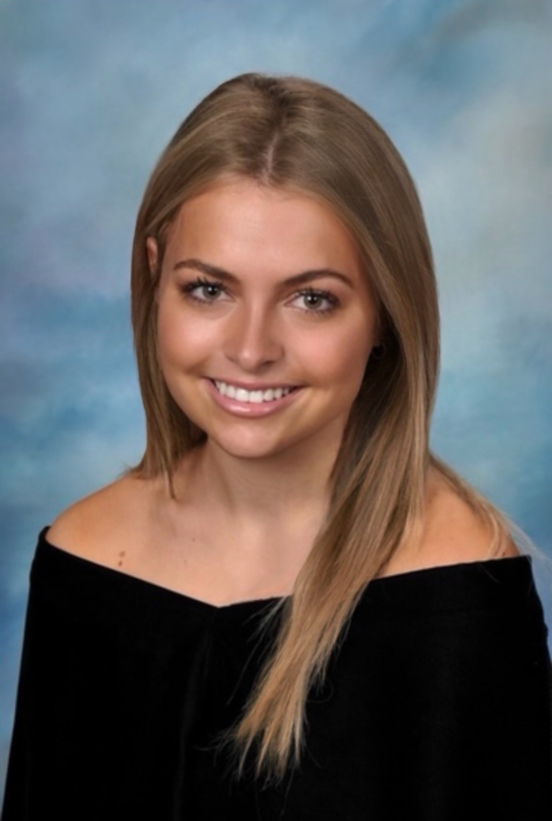

About Us
Jenna Mirabile
Local One
Avery Miller
Integrated Business Solutions
Notes:
AVERY
We were interested in this topic because we have noticed how we are using various other platforms for information and discovery over Google and wanted to delve more into this trend as it relates to advertising

Slide 3
Agenda
Introduction into New Search Trends
Importance of the Changing Nature of Search
Effect on Brand Marketing
Impact on Horizon Media
Q & A
Notes:
AVERY

Slide 4
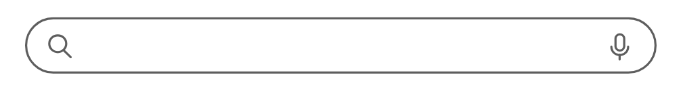
With the emergence of AI and Social Media
How Search is Evolving
Notes:
Avery

Slide 5






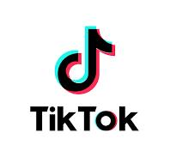



Shift in User Search Behavior
Traditional Platforms AI and Social Media
Generative AI
Conversational interfaces provide summarized recommendations
ChatGPT
Launch
Google Gemini Launch
Amazon Rufus Launch
Google x Reddit to train LLM Model
Google AIO
Launch
Pub Revshare Program
Google AIO
Ads
Launch
ChatGPT links out
to pubs
Meta to develop in-app search engine
Social Media Platforms
Real-time information, product discovery, and eCommerce
Q3 2022
Q4 2022
Q2 2023
Q1 2024
Q2 2024
Q3 2024
Q4 2024
Broadening “Search”
Various platforms and formats, increasing competition for traditional search engines
Perplexity Launch
Instacart Launches
AI Search
Walmart Launches
AI Search
TikTok
Launches AI Search
Meta
Launches AI Chatbot
Snapchat integrates with Gemini
Meta x Reuters to train LLM model
Reddit Answers: AI-powered feature launch
Notes:
Avery
Generative AI (GenAI)
Rapidly expanded, introducing conversational interfaces and AI agents (ChatGPT, Perplexity, Google Gemini) that provide summarized recommendations
Social Media Platforms
Evolved into powerful tools for real-time information, product discovery, and eCommerce
"Search" is Broadening
Across various platforms and formats (text, conversation, video, display), increasing competition for traditional search engines

Slide 6

Reshaping Search
Most significant transformation in search advertising
Reimagining SEO and SEM tactics
Guides brands to shift their marketing strategies
Notes:
AVERY
The trend of new search platforms is reshaping how users discover information, engage with content, and shop online
This is the most significant transformation in search advertising since the emergence of Google and the evolution is just starting
This forces brands to over reconsider their marketing strategies as any platform can be an opportunity for brand discovery and information
Marketers will need to embrace a full-funnel approach of awareness, consideration, and conversion on all platforms where they advertise as users are broadening their solution-seeking and search discovery behavior
There will also be a greater emphasis for prioritizing social media channels in a brand’s advertising mix
Marketers will also need to reimagine their SEO and SEM tactics with broadening opportunities for discovery
For example, there will be a priority for ensuring the content is optimized for AI, so utilizing conversational and more question-answer formats to show up in AI platforms
Also it is important to test keywords in these new technologies to maximize your appearance in AI as AI is going to recognize AI

Slide 7
Impact on Brand Marketing
Notes:
jenna

Slide 8
How Are Users Consuming Content?
32%
use traditional search engines as their first stop search tool
24%
use GenAI as a first stop search tool
41%
use social media as their first stop search tool
Notes:
Jenna
Genrative AI- 24% of gen zers are using AI tools like chatgpt, perplexity or google gemini as their first stop to search.
Social media search – 41% of gen zers use social media sites, reddit, tiktok, Instagram as their first stop to search
Traditional search engines – 32% of gen zers are using traditional search engines like google, bing, yahoo as their first stop to search
For brands, this means showing up in Google isn’t enough—they need to create content that’s searchable on social media and recognizable by AI.

Slide 9
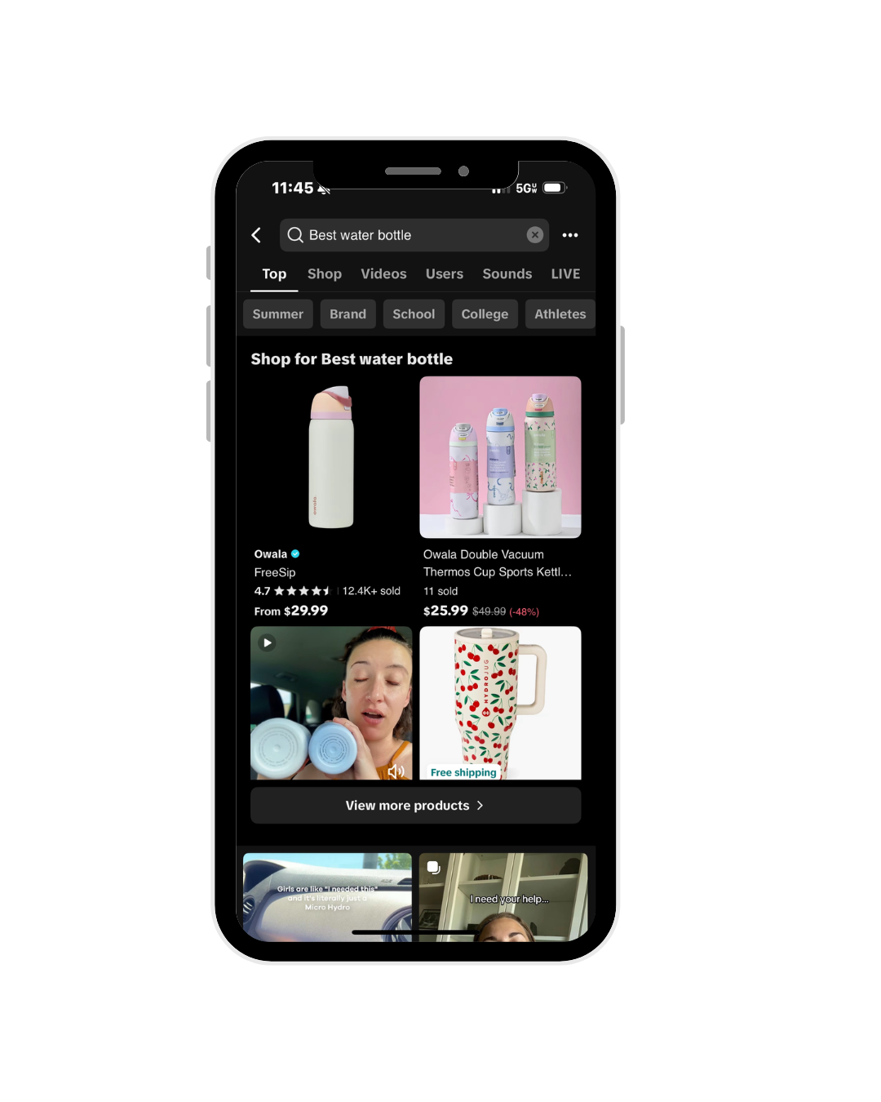
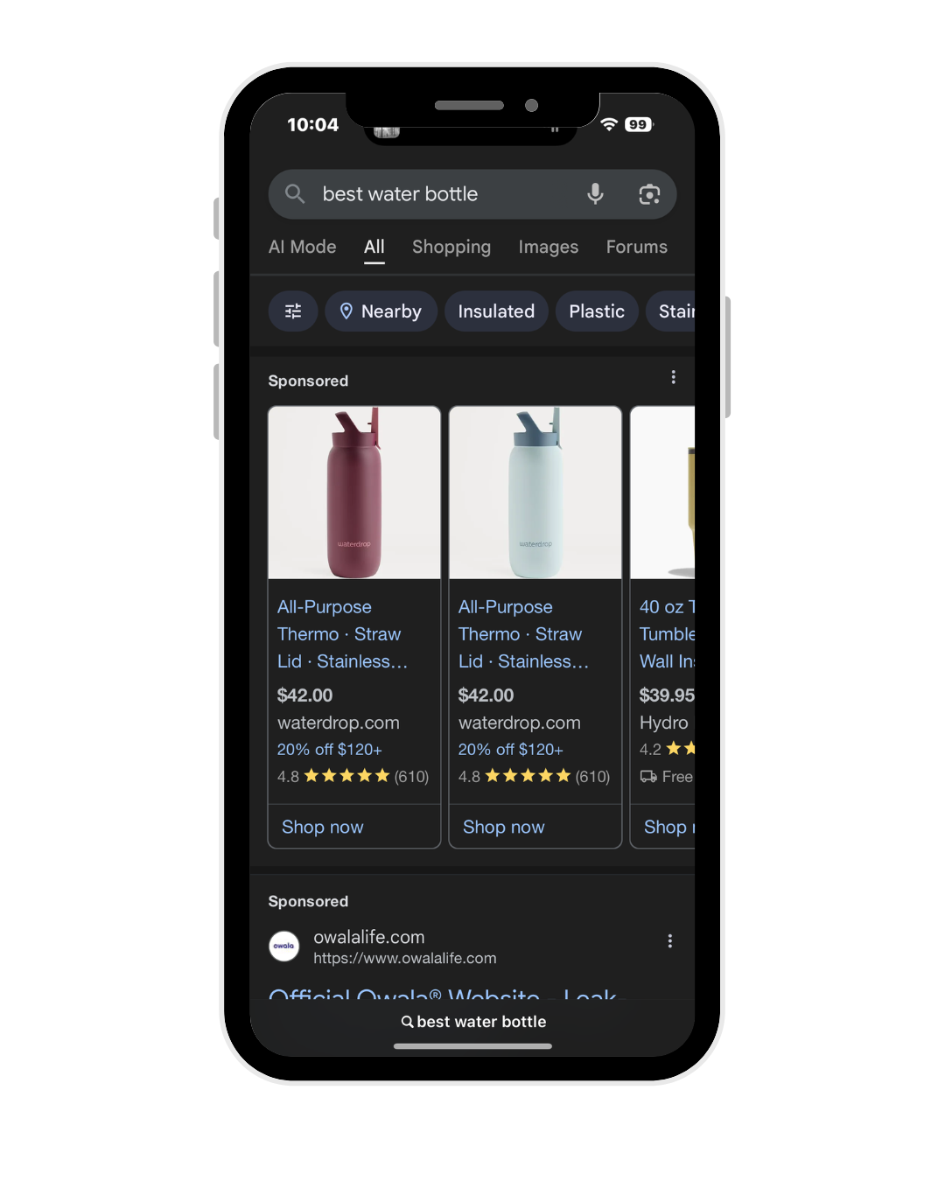
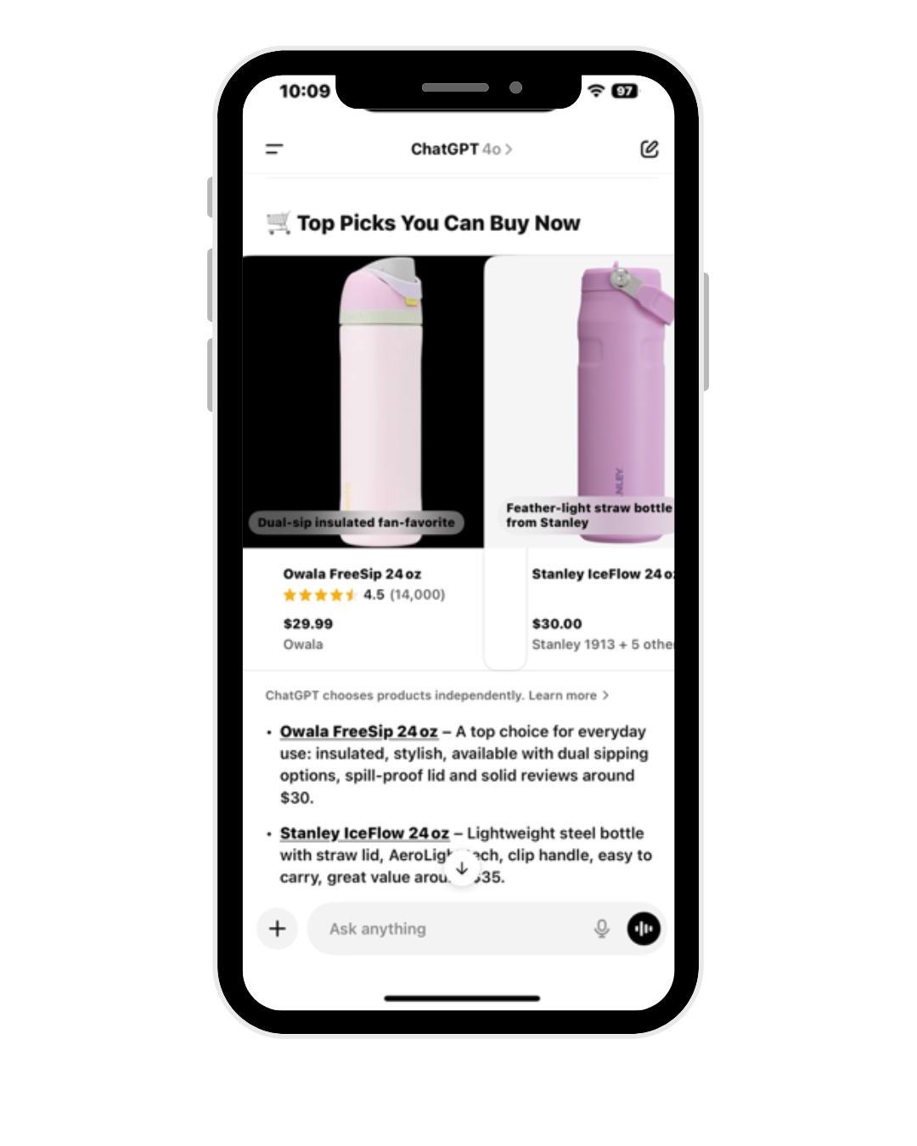
Ads Across Platforms
Google
ChatGPT
TikTok
Notes:
JENNA
as of now here are ads across platforms:
Google – all sponsored brands at top, top 3 links are sponsored
ChatGPT – no ads, chart breakdown, tons of options based on personality
TikTok – one or two sponsored videos, most are made by individual creators

Slide 10

Evolution of Marketing Strategies
Paid Search Adaptation
Organic Search Optimization
Social Media Marketing
Notes:
AVERY
Paid Search Adaptation
AI overviews show on the top of search, pushing traditional sponsored ads further down
This might decrease traffic on sponsored content and paid queries
AI targeting solutions (AI Max, Broad Match) are crucial for paid coverage on trending terms
Broad match uses all available signals to understand the intent of the keyword with the user’s search
AI Max provide keywordless additions to Search Ads campaigns – on top of existing keyword coverage – ​that delivers more reach, and more relevant ads
Consolidating keywords with similar landing pages will improve creative optimization
This allows the systems to learn faster and make more informed decisions on the optimal combinations to serve users
Organic Search Optimization
Focus on authoritative, reputable content to achieve organic visibility
Engagement and social listening on Reddit as AI leverage these sources
Social Media Marketing
TikTok has search campaigns allows keyword-based targeting and other platforms will be soon to follow
In-app shopping features allows direct purchases within the app
Aligning content with search queries can increase brands’ visibility

Slide 11
Challenges
Measurement
Integration
Cross Collaboration
Notes:
JENNA
As search continues to evolve with platforms like TikTok, Instagram, and AI tools becoming part of how people discover information, there are a few key challenges that brands are facing:
Meausurement- It’s becoming more difficult to track and measure performance when people are searching in so many new and different ways. Traditional metrics—like clicks or impressions—don’t always capture the full picture, especially with AI-generated answers or content discovery on social media.
Cross collaboration - The lines between paid search, organic, and social have become blurred.—there has to be strong communication and alignment across departments to make sure messaging and strategy are consistent.
Integration- Each platform requires a different approach. So there’s a real challenge in adapting search strategies to work across all these different spaces in a cohesive way.

Slide 12
With the emergence of AI and Social Media
Impact on Horizon Media
Notes:
JENNA

Slide 13


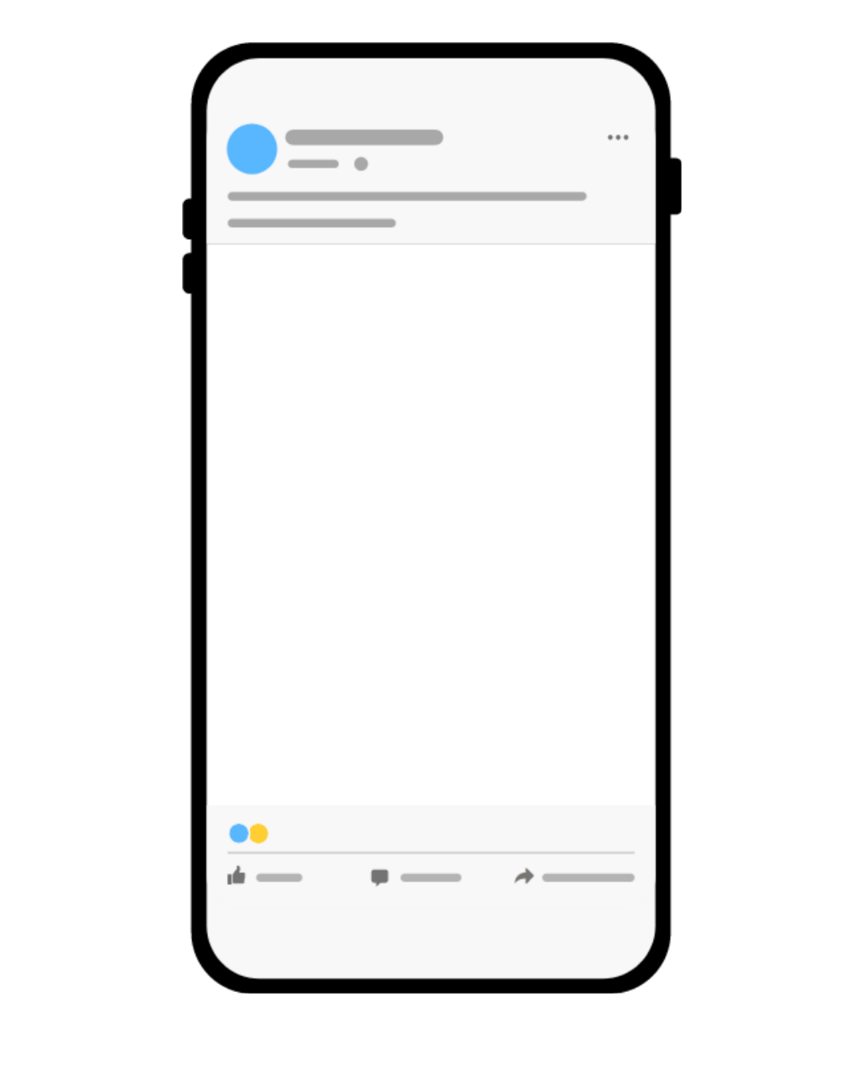
AI-powered media planning.
New key performance indicators.
More spend on social & Influencer.
Content must be searchable in new ways.
Notes:
JENNA
What Does This Mean for Horizon Media?
More spend on social & Influencer
Brands are realizing that if people are searching on TikTok, Instagram, or reddit, that’s where they need to be showing up—so budgets are shifting in that direction. Horizon has to be able to plan for that shift and create content that feels native to those platforms.
AI – powered media planning
- AI is changing the game when it comes to media planning. It’s allowing teams to predict performance, automate optimizations, and personalize campaigns at scale. So horizon should really lena into blu
What’s really interesting is that AI recognizes AI—which means content that’s created using AI tools is more likely to be surfaced or referenced by platforms like ChatGPT or Meta AI.
Content must be searchable in new ways
- investment in keywords or prompts that rank in TikTok / meta search or appear in AI generated responses. If people are asking ChatGPT what shoes to buy or searching for outfit inspo on Pinterest or TikTok, then brands need to make sure their content is actually optimized for those platforms—not just Google.
New KPIs
moving beyond CTR and measuring saves, shares, mentions in AI generated responses and engagement
So overall, this shift is really forcing Horizon to evolve across strategy, creative, and measurement—and stay ahead of how search is changing.

Slide 14
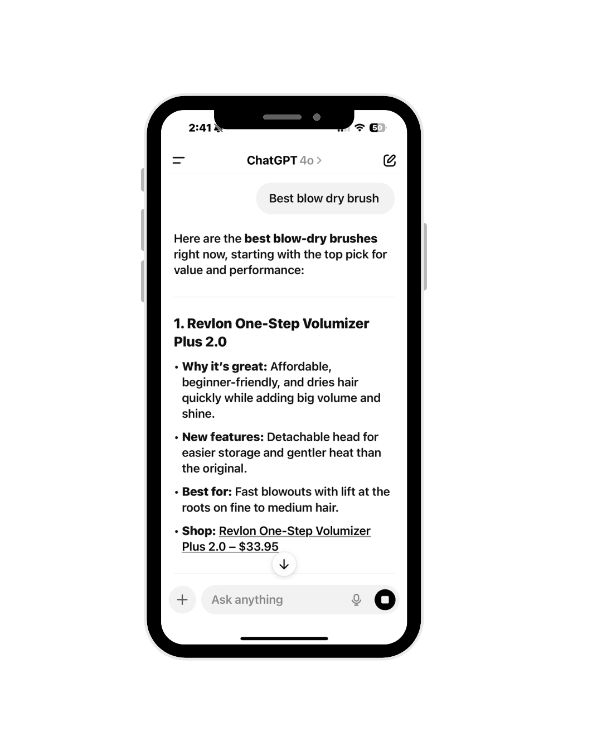
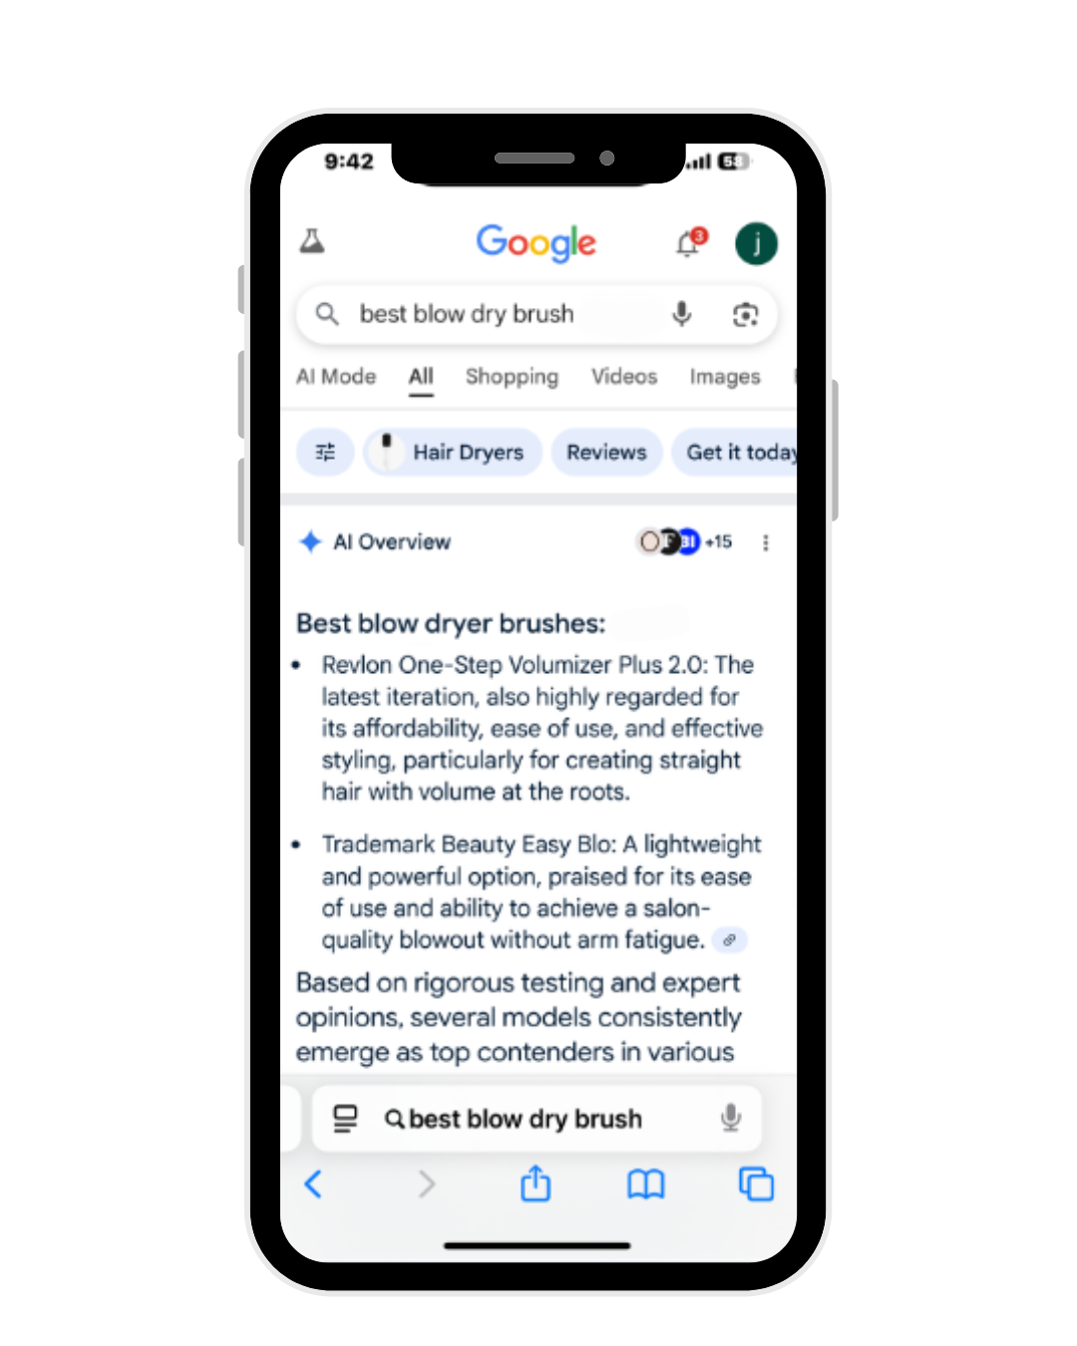
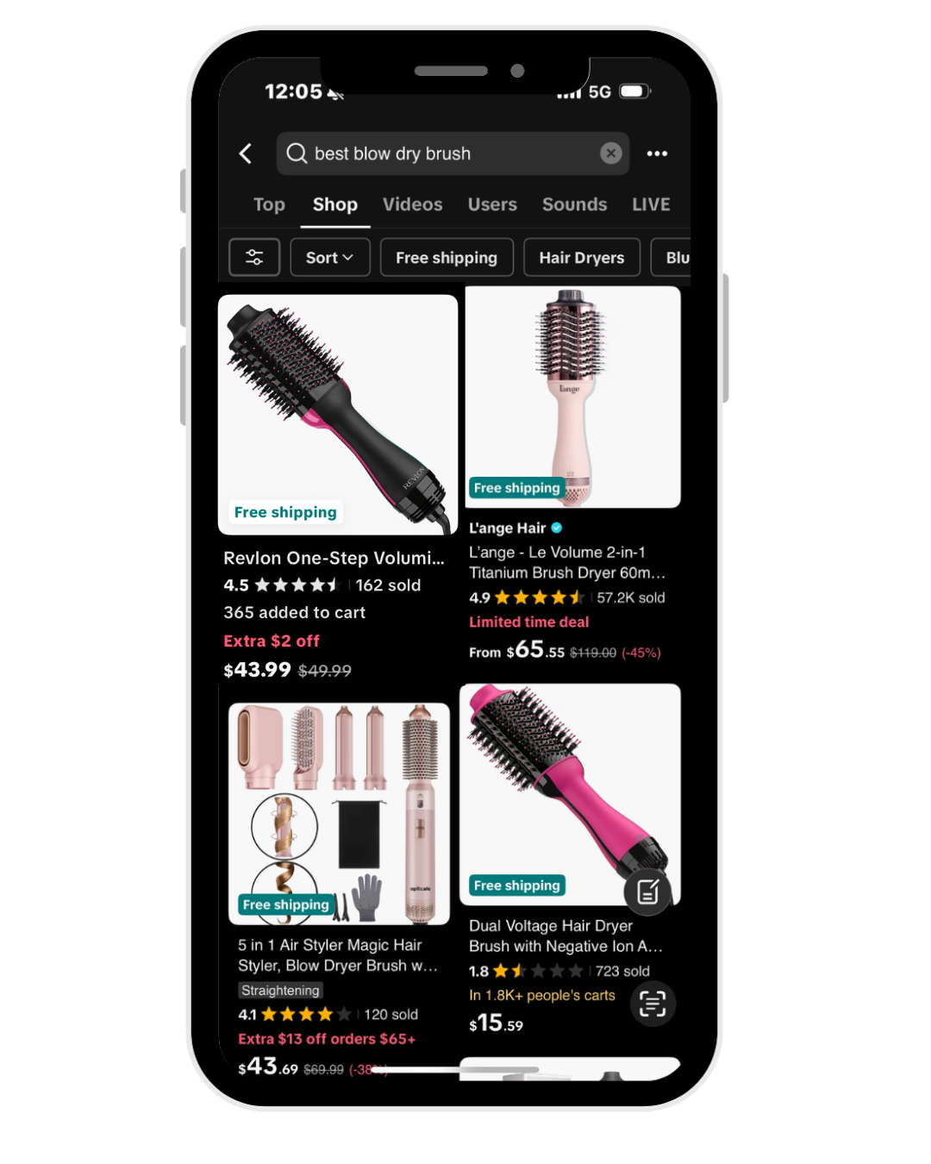
Future of Search: Revlon
Google
ChatGPT
TikTok
Notes:
AVERY
This is an example of what the future of search can look like using the example of Revlon optimizing search on seach engines, AI, and social media

Slide 15
Looking Forward
Discovery is evolving, and so should we.
Notes:
JENNA
As AI and social media continue to reshape how users search and engage…
Horizon Media is uniquely positioned to lead brands into the next era of consumer behavior.

Slide 16
Thank you!
Q&A
Notes:
JENNA

Slide 17
Sources
Slide 5
Slide 6
Slide 7: ChatGPT as a Search Engine | Adobe
Social Media Surpasses Search Engines as Gen Z Go-To Tool – Localogy
Gen Z Prefers Social Media Over Google for Search, New Study Shows | SPT Stock News
Slide 8
Slide 9

